Slide 1


SRI KRISHNA ARTS AND SCIENCE COLLEGE Coimbatore – 641 008
Department of IT and CG
Industrial Exposure Training
Date - July 27th 2024
Guide Name : Mrs. Ramya .U
Register Number:22BCG045
Student Name: Sathya Narayanan. S

Slide 2
Introduction to the company
Net Tel Solution India Pvt Ltd is a leading provider of software , Telecom Electrical and Network Managements.
Net Tel Solution is Service and product Based Company
They pride themselves in the fact that they have a loyal customer base of many clients.
Net Tel Solutions India Private Limited was established in 2013 by leading experts in the field of Telecom Industries.

Slide 3
Role as an Intern
As an intern in full stack development, I’m assist in building and maintaining web applications, gaining hands-on experience with both front-end and back-end technologies. You'll collaborate with senior developers, contribute to coding tasks, and continuously learn and improve your skills through feedback and mentorship.

Slide 4
Problem Definition
Traditional methods of locating mechanics and garages are cumbersome and lack transparency. Issues such as long wait times, unclear service processes, and inconsistent communication lead to customer dissatisfaction. Mechanics and shop owners, on the other hand, struggle with managing appointments, tracking service requests, and maintaining operational efficiency. There is a need for a streamlined, transparent, and efficient system that can bridge the gap between vehicle owners and service providers, enhancing customer experience and optimizing business operations.

Slide 5
Limitations of Existing System
Poor Financial Management:
Financial record keeping is often manual and disconnected from other process , leading to inaccuracies and inefficiencies and existing system lack integrated account book management , making financial transparency challenging
Limited Operational Insights:
Existing system do not provide offers comprehensive dashboard and operational metric and performance

Slide 6
Limitations of Existing System
Inadequate Customer Engagement:
Current system do not provide sufficient means for customers to interact with service provider

Slide 7
Proposed System
Enhance Transparency and Trust
Provide vehicle owners with a reliable platform to raise service tickets, track service status, and receive updates.
Optimize Operational Efficiency
Provide a comprehensive job portal with performance dashboard ,employee management tools and job scheduling capabilities
Enable shop owners to monitor and maintain financial transparency

Slide 8
Proposed System
Enhance Business Performance
Optimize service delivery and operational efficiency to enhance overall business performance.
Improve Customer Interaction
Streamline Service Management

Slide 9
Hardware and Software Requirement
Processor: AMD Ryzen 5 3500U (or equivalent)
RAM: 8GB
Storage: 256GB SSD (Solid State Drive)
Graphics: Integrated AMD Radeon Vega 8 Graphics
Operating System: Windows 10/11, macOS, or Linux (Ubuntu 20.04 or later)

Slide 10
Development Environment
Frontend
Vite + React JS , Tailwind CSS
Backend tool
Node JS , Express JS, Mongo Atlas
Hardware
Processor AMD 5000 series 3500U
RAM 8GB

Slide 11
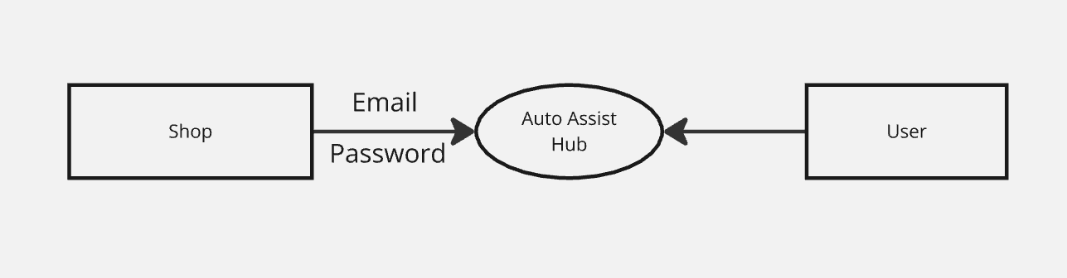
System Design
DFD Level 0

Slide 12
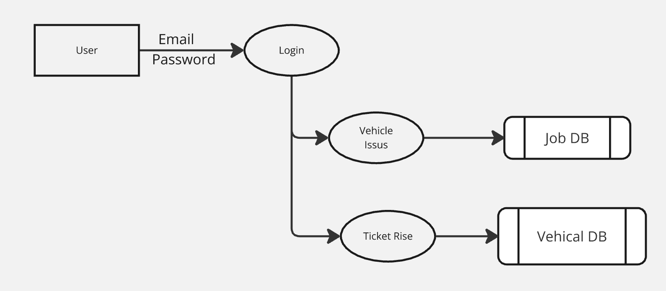
System Design
DFD Level 1

Slide 13
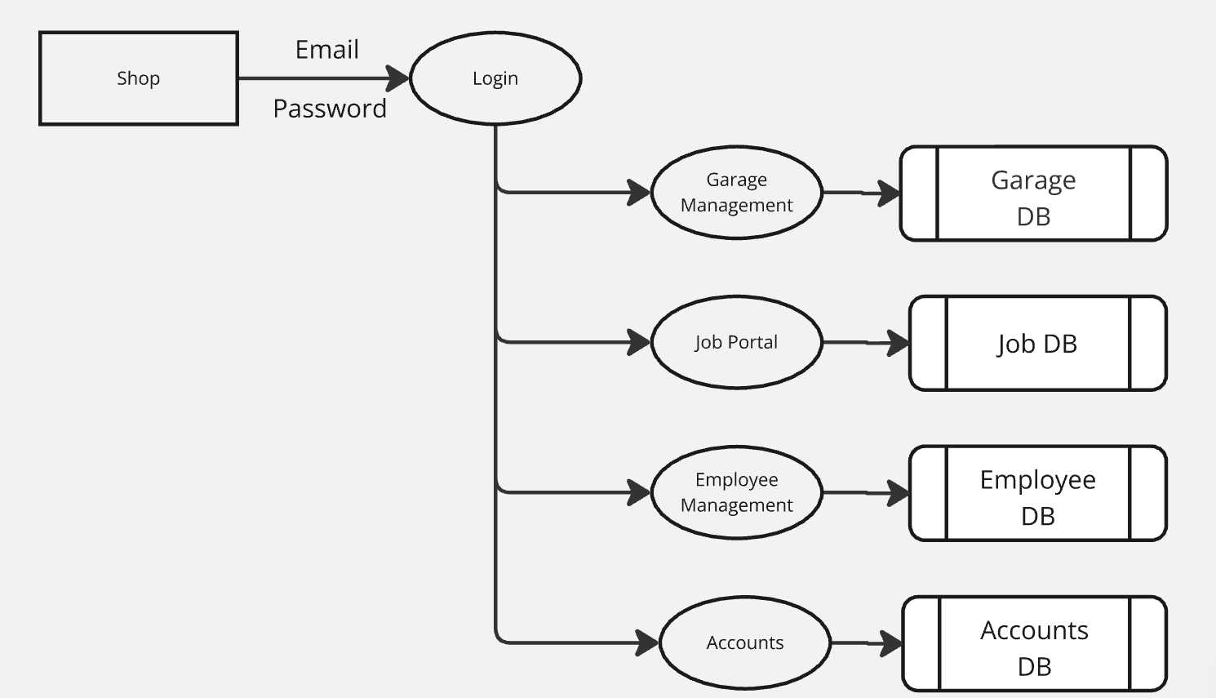
System Design
DFD Level 2

Slide 14
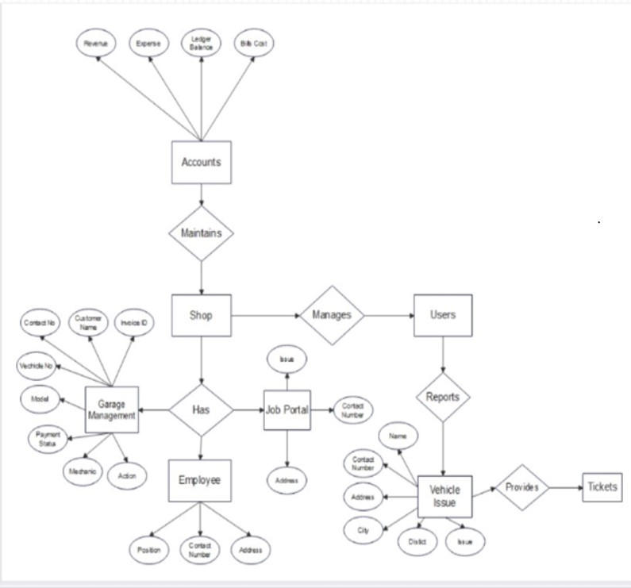
System Design
ER Diagram

Slide 15
Modules and Description
Shop Signup
Shop Dashboard
Employee Management
Garage Management
Account Management
User Ticket Rising

Slide 16
Modules and Description
Shop Signup:
Allows mechanics shop owners to create account
Shop Dashboard:
Central hub for managing shop operations.
Provides key performance metrics:
Number of service requests
Ongoing jobs

Slide 17
Modules and Description
Garage management:
Streamlines daily operations.
Manages service requests, appointment scheduling, and job tracking.
Account management:
Offers comprehensive financial management tools.
Maintains accurate records.

Slide 18
Modules and Description
User ticket raising:
Simplifies service request process for vehicle owners.
User-friendly interface.
Allows users to:
Describe vehicle issues
Select required services
Submit service requests

Slide 19
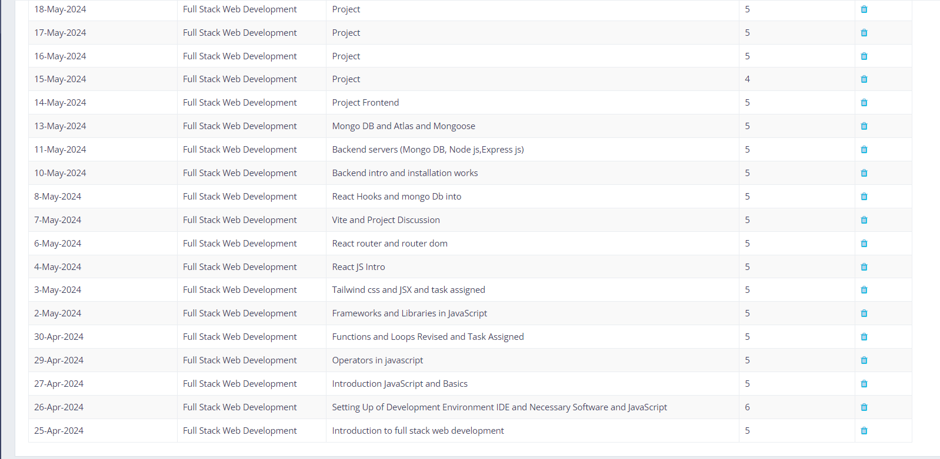
TimeSheet

Slide 20
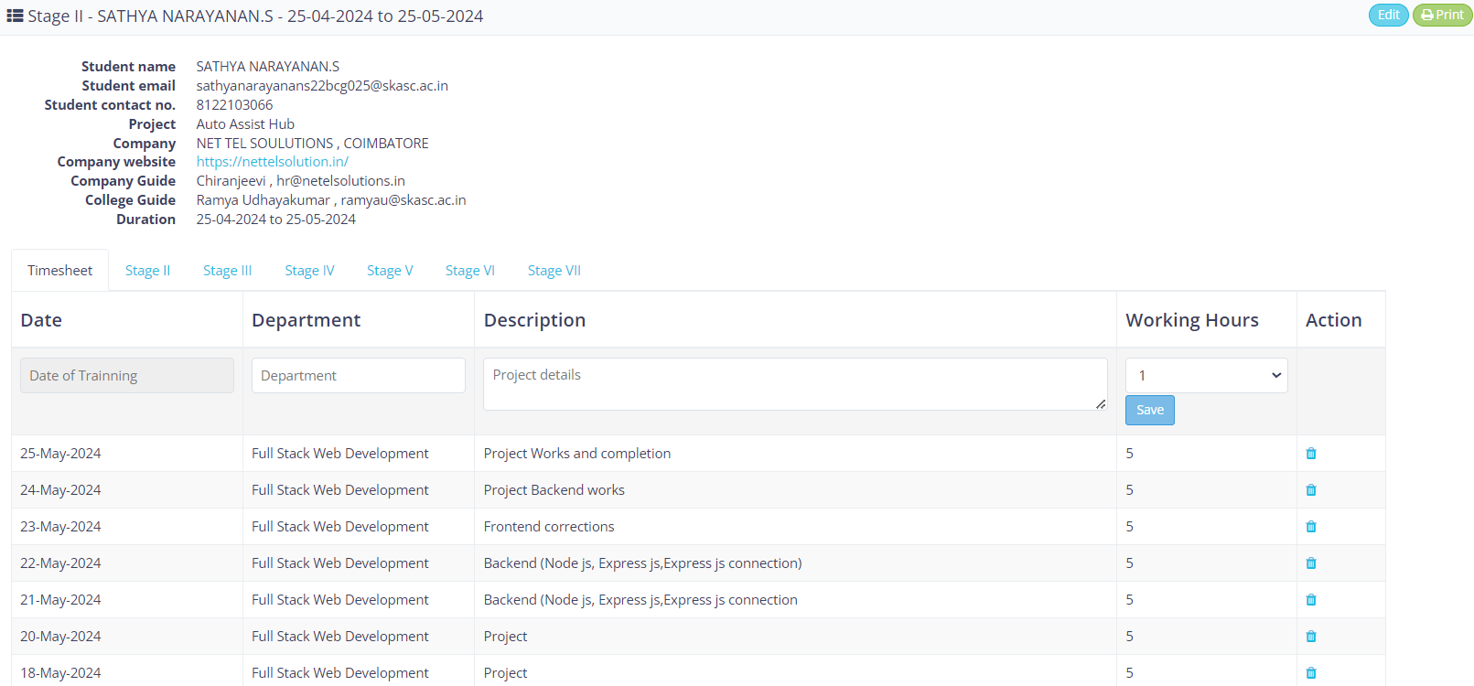
TimeSheet

